Slide 1

CHAPTER 1
Generative AI
A New Frontier for Scientific Discovery
Transformers
Diffusion Models
Scientific ML
AI Co-Scientists
J. Paul Liu, 2026. Generative AI For Science. Leanpub,
https://leanpub.com/generativeaiforscience

Slide 2




The New Frontier of Scientific Discovery
For centuries, discovery has been limited by human capacity. Generative AI is not merely automating workflows—it is expanding what is scientifically possible.
DRUG DISCOVERY
PROTEIN STRUCTURE
WEATHER FORECAST
HYPOTHESIS GEN
10-15 yrs → 3-5 yrs
AlphaFold 3
Hours → Minutes
Years → Days
80-90% Phase I success
Nobel Prize 2024
GenCast 97% better
AI Co-Scientists
The transformation is both quantitative and qualitative: AI enables scientists to explore vast combinatorial spaces and ask "what if?" at scales that would be infeasible with manual or purely equation-based approaches.
Literature Review
Experimental Design
Data Analysis
Scale
Synthesizes millions of papers
Proposes thousands of candidates
Finds structure in high-dim data
Millions of in silico screens
J. Paul Liu, 2026. Generative AI For Science. Leanpub, https://leanpub.com/generativeaiforscience

Slide 3


The AI Revolution: From Analysis to Generation
Scientific computing has evolved through clear stages:
1960s-1980s
DIGITIZATION
Databases → Data preservation
1990s-2010s
STATISTICAL & ML METHODS
Regression, SVMs, Random Forests → Pattern recognition
2020s+
GENERATIVE AI
Transformers, Diffusion Models → Creation of new data and hypotheses
TRADITIONAL ML
GENERATIVE AI
Discriminative: Classification, regression, clustering
Generative: Learn the distribution, create new instances
Learn mappings from inputs to outputs
Sample to create realistic, novel outputs
J. Paul Liu, 2026. Generative AI For Science. Leanpub, https://leanpub.com/generativeaiforscience

Slide 4
Generative AI Capabilities
Generative models learn the distribution underlying data and can sample from it to create new, realistic instances:
G
C
T
S
Generation
Completion
Translation
Synthesis
Design a new molecule with desired properties
Fill missing regions in protein structures
Text description to molecule, code, or figure
Combine text, code, and data into new analyses
Novel compounds
Biological variants
Cross-modal synthesis
Simulations, visualizations
SCIENTIFIC DISCOVERY LOOP — COMPRESSED BY AI
Observe
→
Hypothesize
→
Experiment
→
Analyze
→
Repeat
J. Paul Liu, 2026. Generative AI For Science. Leanpub, https://leanpub.com/generativeaiforscience

Slide 5



Core Technologies Powering Generative AI
1. Transformers and LLMs
2. Diffusion Models
3. VAEs and GANs
Attention-based architecture modeling long-range dependencies in sequences
Reverse gradual noising to generate high-fidelity samples
Earlier but foundational frameworks for generative modeling
Summarize scientific literature
Molecular and materials design
Low-dim latent representations
Generate analysis code
AlphaFold 3 protein prediction
Synthetic dataset augmentation
AI co-scientists for hypotheses
GenCast weather forecasting
Surrogate models for simulations
J. Paul Liu, 2026. Generative AI For Science. Leanpub, https://leanpub.com/generativeaiforscience

Slide 6
The Pre-Training Revolution
Domain Adaptation Examples
Biomedicine
Modern generative AI thrives on pre-training: models are first trained on large, generic corpora and then fine-tuned on specific tasks.
Language model pre-trained on broad text → adapted to medical literature and clinical notes
Large Generic Corpus
Pre-trained Model
Fine-tuned Model
Materials Science
→
→
Foundation model → fine-tuned for catalyst discovery and battery material optimization
Text, code, images
General knowledge
Domain-specific
Protein Science
Why This Matters for Science
Model pre-trained on millions of sequences → specialized for narrow protein family with small dataset
High-quality labeled data is often scarce or costly in science. Pre-training leverages vast generic data, then small task-specific datasets enable specialization.
Geosciences
Earth system foundation models → regional climate prediction and extreme event analysis
J. Paul Liu, 2026. Generative AI For Science. Leanpub, https://leanpub.com/generativeaiforscience

Slide 7

APPLICATIONS
Physical, Chemical Sciences and Drug Discovery
CHEMISTRY AND DRUG DISCOVERY
Novel Therapeutics
PHYSICAL AND CHEMICAL SCIENCES
Propose new antibiotics with desired efficacy and safety profiles
Materials Design
Multi-Objective Optimization
Explore enormous chemical spaces for superconductors, catalysts, battery materials
Balance binding, solubility, toxicity, synthesizability
Reaction Planning
Clinical Acceleration
Suggest products and retrosynthetic routes from concept to synthesis
AI candidates: ~90% Phase I success vs 40-65% industry average
Mathematical Reasoning
AlphaProof/Gemini achieved gold-medal IMO standard (2025)
TIMELINE REDUCTION
10-15 → 3-5 years
Drug discovery with AI assistance
J. Paul Liu, 2026. Generative AI For Science. Leanpub, https://leanpub.com/generativeaiforscience

Slide 8

APPLICATIONS
Life and Environmental Sciences
Climate and Earth System Science
PROTEIN ENGINEERING
GenCast Weather Forecasting
AlphaFold 3
Outperforms ECMWF ENS in 97% of scenarios
15-day forecasts in 8 minutes
Predicts structure and interactions of proteins, DNA, RNA, ligands, and ions
50%+ improvement over existing methods
Earth System Foundations
Aurora and WeatherNext integrate atmosphere, ocean, land, cryosphere
Genomics
Medical AI
Modeling sequence-function relationships
Risk prediction and trial design
Surrogate Modeling
Physics-informed surrogates at fraction of compute cost
J. Paul Liu, 2026. Generative AI For Science. Leanpub, https://leanpub.com/generativeaiforscience

Slide 9
Mathematical Foundations and Methods
Generative AI is driving progress in the mathematics and methodology of scientific machine learning:
∂
dx
σ
∀
Physics-Informed NNs
Data-Driven Dynamics
Uncertainty Quantification
Formal Reasoning
Incorporate PDEs and physical constraints directly into neural network training
Learn governing dynamics and control laws directly from measurements
Quantify confidence and propagate uncertainty through AI pipelines
AlphaProof: RL + formal theorem proving in Lean for verifiable proofs
CROSS-CUTTING CAPABILITIES
Physics-Informed Models
Latent Representations
Multimodal Integration
Multi-Agent AI
Embed conservation laws, symmetries, PDEs
VAEs, GANs, diffusion for compact encodings
Text, images, time series, spatial fields
AI co-scientist with debate and evolution
J. Paul Liu, 2026. Generative AI For Science. Leanpub, https://leanpub.com/generativeaiforscience

Slide 10

A New Scientific Partner
What Generative AI Enables
"Generative AI is not replacing scientists—it is becoming a new kind of collaborator."
Expand the hypothesis space far beyond what any team could enumerate
Accelerate cycles of modeling, simulation, and experiment
The most impactful discoveries are likely to emerge where human insight and machine-generated ideas interact in a tight loop.
Enable researchers with limited resources to use state-of-the-art tools
AI Co-Scientist (Google, 2025)
Bridge separate fields by revealing shared patterns in data and models
Multi-agent framework with specialized agents for hypothesis generation, debate, and evolution. Recapitulates discoveries in days that previously required years of research.
Scientists who understand and apply generative AI will stand at the forefront of discovery in every field.
J. Paul Liu, 2026. Generative AI For Science. Leanpub, https://leanpub.com/generativeaiforscience

Slide 11
Key Takeaways
THE PATH FORWARD
THE TRANSFORMATION
Understand Architectures
1
Generative AI creates new data and hypotheses, not just recognizes patterns
Transformers, diffusion models, scientific ML
2
Core technologies: Transformers, Diffusion Models, VAEs/GANs
Adapt to Your Domain
Fine-tune models for your specific scientific domain
3
Pre-training + fine-tuning overcomes data scarcity in specialized domains
4
AI is a collaborator, not a replacement—human insight + machine ideas
Evaluate Rigorously
Statistical and physical validation checks
IMPACT METRICS
Design Human-AI Workflows
80-90%
50%+
97%
AI accelerates, rather than distorts, science
Phase I success
AlphaFold 3 gain
GenCast better
The revolution is already underway.
J. Paul Liu, 2026. Generative AI For Science. Leanpub, https://leanpub.com/generativeaiforscience

Slide 12
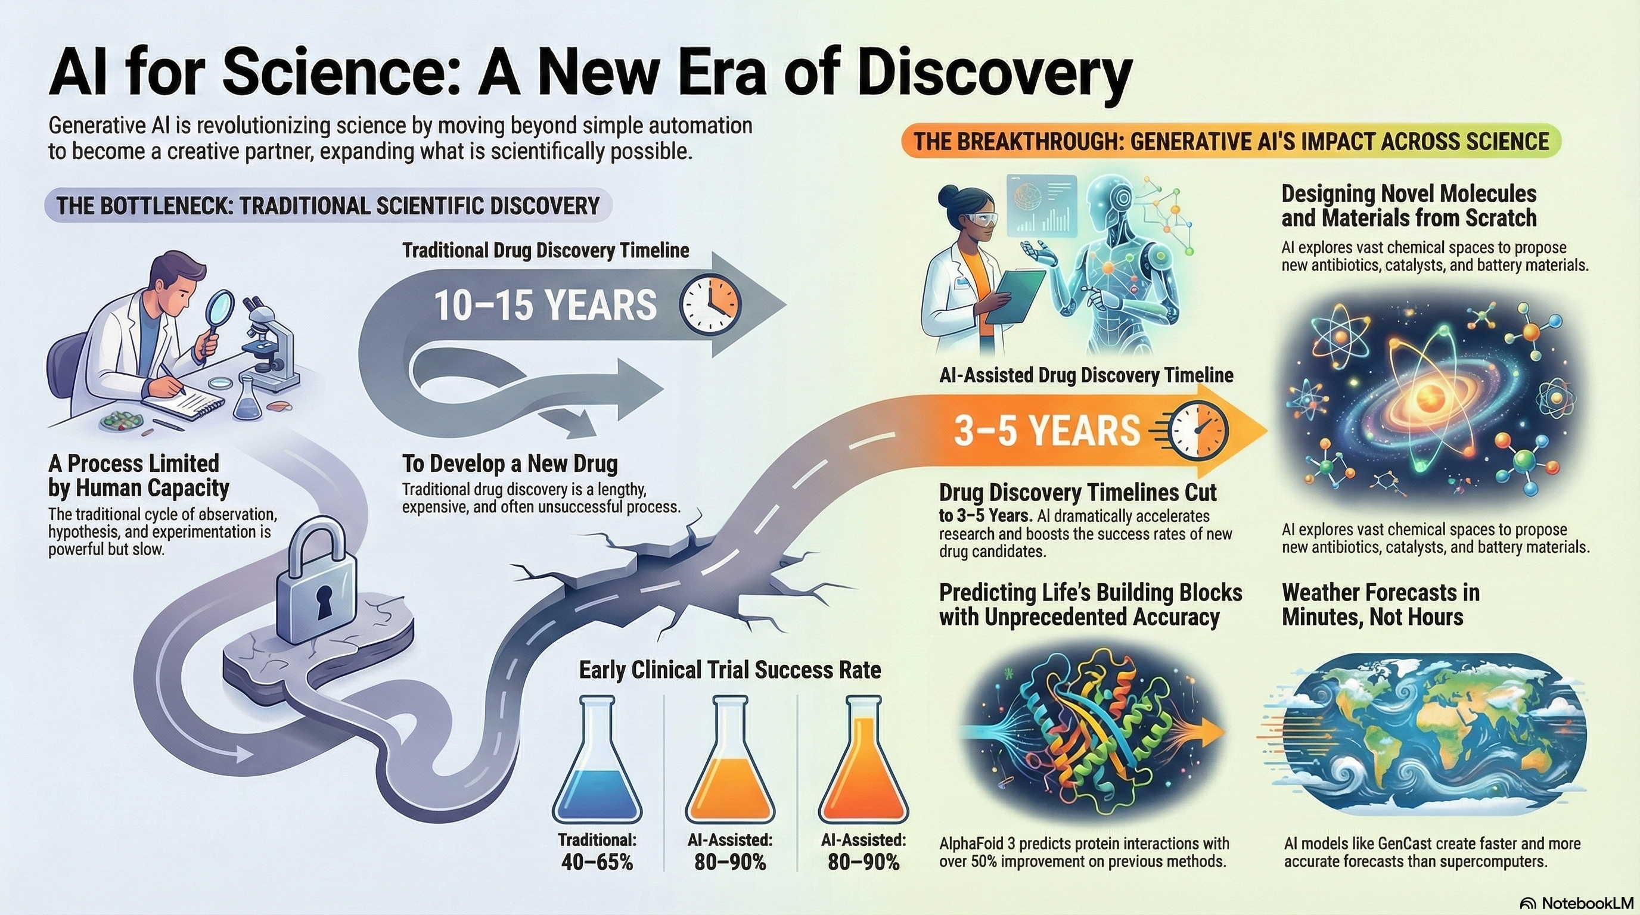
J. Paul Liu, 2026.
Generative AI For Science. Leanpub, https://leanpub.com/generativeaiforscience

Slide 13
References and Further Reading
KEY PAPERS
SCIENTIFIC ML RESOURCES
Wang et al. (Nature 2023)
Raissi et al.
Brunton & Kutz
Scientific discovery in the age of AI
Physics-Informed NNs
Data-Driven Science
Abramson et al. (Nature 2024)
BOOK RESOURCES
AlphaFold 3: Biomolecular interactions
Full Working Code:
Price et al. (Nature 2024)
rewriting.ai/bookcode/ai4sci.php
GenCast: Probabilistic weather forecasting
Gottweis et al. (arXiv 2025)
Book Information
Towards an AI co-scientist
J. Paul Liu, 2026
Generative AI For Science
Leanpub
Vaswani et al. (NeurIPS 2017)
Attention Is All You Need
Ho et al. (NeurIPS 2020)
Next Chapter
Denoising Diffusion Probabilistic Models
Chapter 2 — LLMs for Scientific Applications
J. Paul Liu, 2026. Generative AI For Science. Leanpub, https://leanpub.com/generativeaiforscience

